Slide 1
Project Presentation – Stock price prediction
Team -13
Arijit Majumdar
Pushpam Kumar
Pravati Padhy
Phani Raju R

Slide 2
Summary
The NIFTY 50 is a benchmark Indian stock market index that represents the weighted average of 50 of the largest Indian companies listed on the National Stock Exchange.
In this project we will provide two-fold views to traders so they can take best possible decision – predicting closing price and a recommendation to trader whether they should buy, sell or hold the share.
The datasets we used to perform the analysis are:
Nifty-50 dataset
FII data
DII data
Nifty-sector data

Slide 3
Getting the data
Nifty-50 CSV data is obtained from Kaggle.
FII and DII data are obtained from NSE site.
Sectors for each companies are obtained from Google.
To reduce timeframe for training the data, we used one Nifty-50 company here (Infosys) for Jan, 2019- April, 2021 period.. However, the model will properly work with other Nifty-50 companies and requested timeframe.

Slide 4
Understanding the data
Nifty-50 data has 12 numeric and 2 categorical variables.
FII and DII data has one categorical and 2 numeric variables.
Sector data has 3 categorical variables.

Slide 5
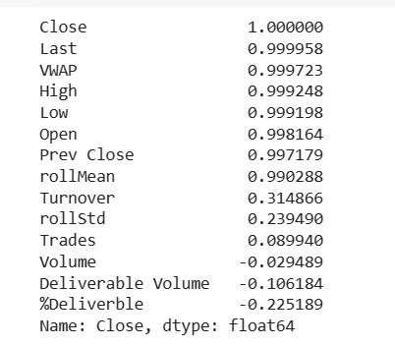
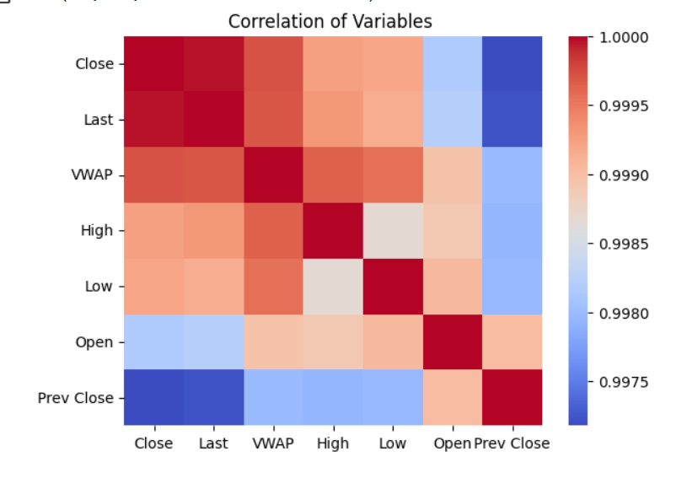
Discover and Visualize the Data to Gain Insights - Correlation

Slide 6
Prepare the Data for Machine Learning Algorithms
We prepared the data for machine learning through Pipeline mechanism.
Here we have used DataFrameSelector customized class along with BaseEstimator, TransformerMixin to transform the data by selecting the desired attributes, and converting the resulting DataFrame to a NumPy array.
The Pipeline used selector, imputer, standard scaler for numerical attributes and selector, OneHotEncoder for categorical attributes.

Slide 7
Train the model

Slide 8
Sentiment analysis
Used SentimentIntensityAnalyzer from Natural Language Toolkit, Article from newspaper, and googlesearch.
We performed following sentiment analysis:
Symbol market sentiment analysis
Sector market sentiment analysis
FII and DII sentiment analysis

Slide 9
ARIMA and SARIMAX
Auto-Regressive Integrated Moving Average
AutoRegressive (AR):
Current values on its own previous values
AR(p) – Current Values depend on its own p-previous values.
P is order of AR process
Integrated (I):
The "I" stands for differencing.
This involves subtracting the previous value from the current one.
Moving Average (MA):
Current deviation from mean depends on previous devaitions.
MA(q) – the current deviation from mean depends on q-previous deviations
P is order of AR process
In simpler terms, ARIMA combines information from the past values, differences between values, and past prediction errors to make predictions about future values in a time series.

Slide 10
ARIMA and SARIMAX
During our research we found ARIMA is particularly useful in time series forecasting due to its ability to capture and model various patterns and trends in the data. AutoRegressive (AR): "First up, we have the 'AR' or AutoRegressive component. This means that the current values depend on their own previous values. If we denote the order of this process as 'p,' it means the current values are influenced by the p-previous values."
Integrated (I): "Now, let's talk about the 'I,' which stands for differencing.
differencing involves subtracting the previous value from the current one. This step helps make the time series data more stable and easier to work with."
Moving Average (MA): 'MA' or Moving Average component. This means that the current deviation from the mean depends on previous deviations. If we denote the order of this process as 'q,' it signifies that the current deviation from the mean is influenced by q-previous deviations."

Slide 11
ARIMA and SARIMAX
Seasonal AutoRegressive Integrated Moving Average with eXogenous
SARIMAX = Seasonality + ARIMA + eXogenous(X)
In simple terms, SARIMAX extends ARIMA by adding the ability to model seasonality and include external factors that may impact the time series. It's a more flexible model for time series forecasting that can handle both the inherent patterns in the data and the influence of external factors.

Slide 12
ARIMA and SARIMAX - Lifecycle
Check Stationarity:
Stationary means that statistical properties like mean and variance do not change over time.
If the data is not stationary, you may need to difference the series.
Differencing (if needed)
If data is not stationary, apply differencing to make it stationary.
Differencing involves subtracting the previous value from the current one. This may be required more than once if higher orders of differencing are require
Autocorrelation (ACF) and Partial Autocorrelation (PACF)
Examine the Autocorrelation Function (ACF) and Partial Autocorrelation Function (PACF) plots to determine the order of the ARIMA model (p, d, q).
Identify seasonal order for Seasonality
Model Parameters Selection:
Based on the ACF and PACF plots, select appropriate values for the AR (p), Integrated (d), and MA (q) parameters.
This defines the order of the ARIMA model (p, d, q).
Repeat for SARIMAX with seasonal Order
Train & Evaluate:
The training set is used to train the ARIMA model.
Fit the ARIMA model to the training data using the selected order (p, d, q). Evaluate the model performance on the testing set: Metric used by us is RMSE.

Slide 13
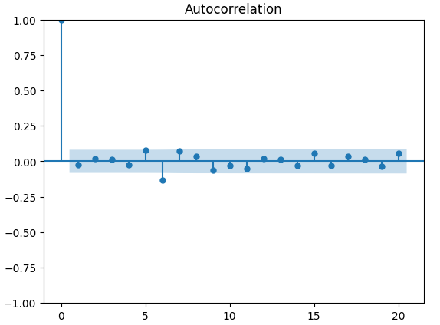
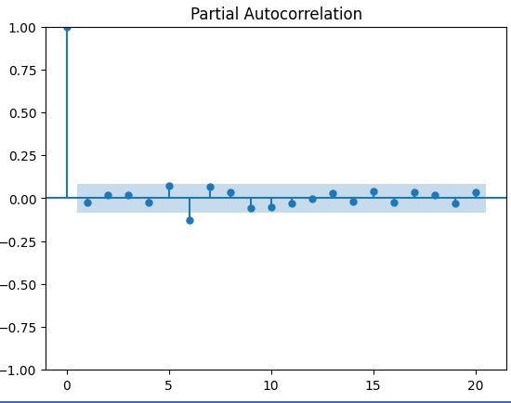
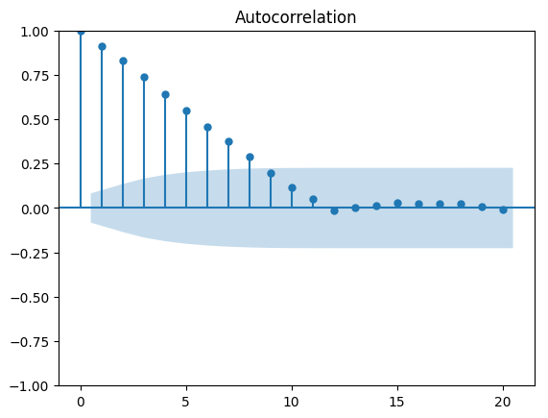
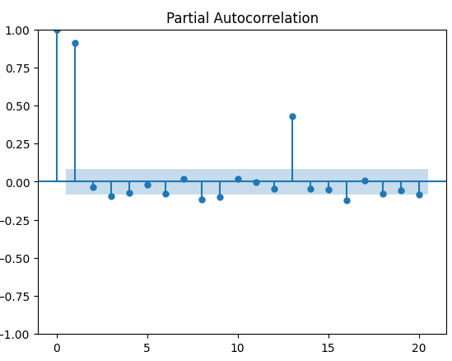
ARIMA and SARIMAX - Lifecycle

Slide 14
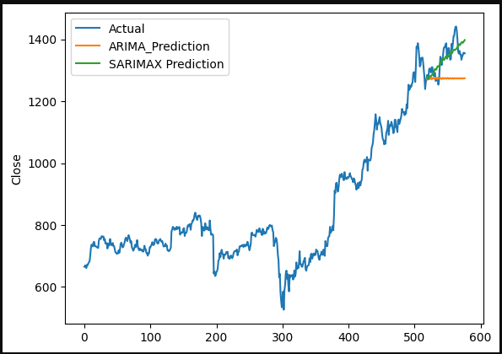
ARIMA and SARIMAX - Evaluation
RMSE ARIMA - 81.16
RMSE SARIMAX - 33.26
Order (6, 1, 6)
Seasonal_Order (1,1,6,12)

Slide 15
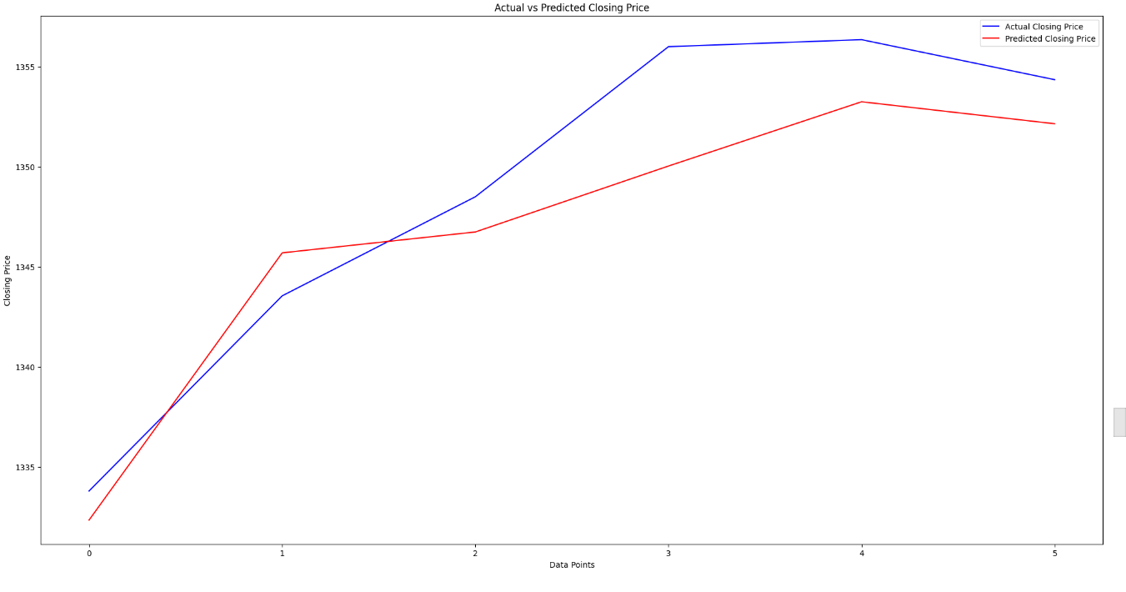
RandomForestRegressor
RandomForestRegressor:
The RandomForestRegressor is an algorithm used for regression tasks, and it is part of the ensemble learning methods in machine learning. It belongs to the family of tree-based models and is an extension of the random forest algorithm, which is commonly used for classification tasks.
RMSE – 3.16

Slide 16
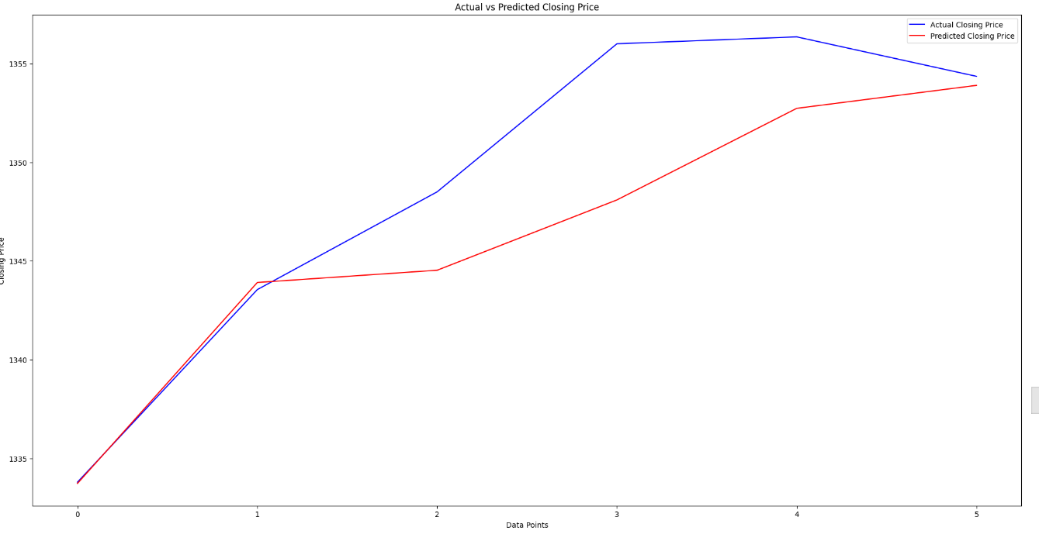
GridSearchCV with RandomForestRegressor
GridSearchCV:
Grid Search Cross-Validation) is a technique used for hyperparameter tuning in machine learning. It is a method to systematically search through a predefined set of hyperparameter values for a given model. The goal is to find the combination of hyperparameter values that yields the best performance for a specific evaluation metric.
RMSE – 3.91

Slide 17
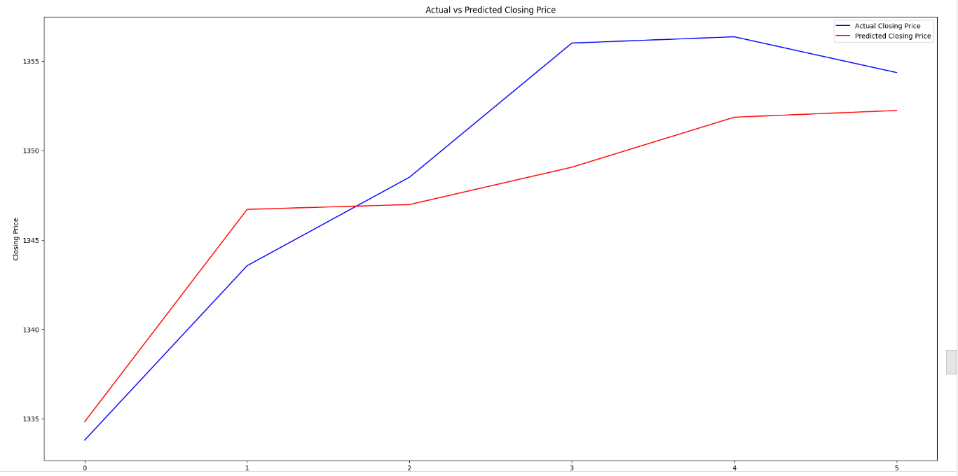
RandomizedSearchCV with RandomForestRegressor
RandomizedSearchCV:
Is another hyperparameter tuning technique in machine learning, similar to GridSearchCV. Like GridSearchCV, it is used to search through a set of hyperparameter values to find the combination that results in the best model performance.
RMSE – 3.79

Slide 18
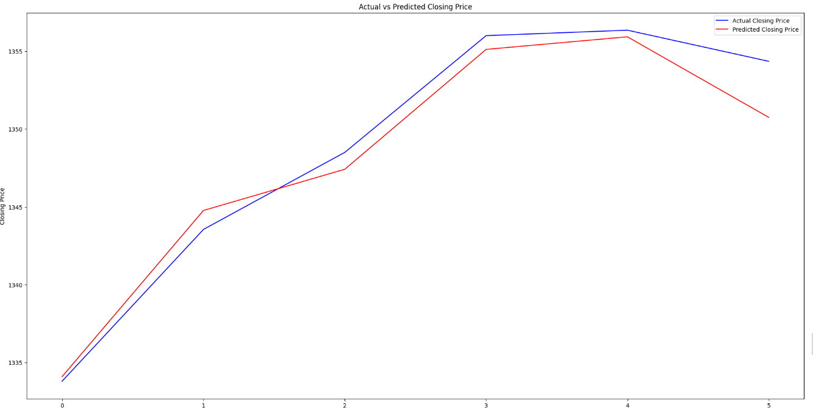
LinearRegression
LinearRegression:
Fundamental linear modeling technique used in machine learning and statistics. It is a supervised learning algorithm used for predicting a continuous outcome variable (also called the dependent variable) based on one or more predictor variables (independent variables). The algorithm assumes a linear relationship between the predictor variables and the target variable.
RMSE – 1.67

Slide 19
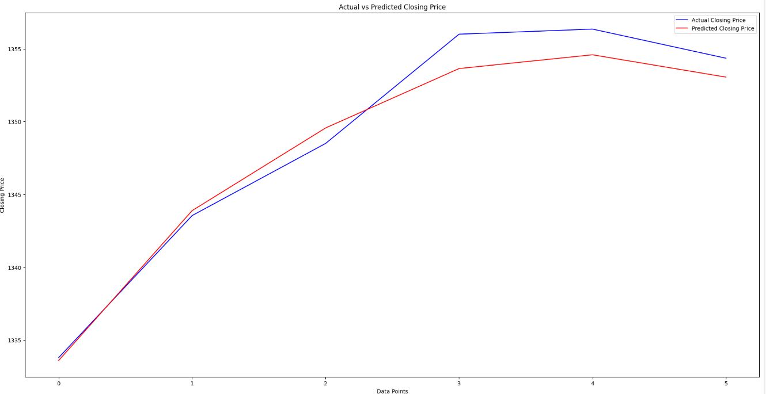
XGBoost
XGBoost:
XGBoost, which stands for eXtreme Gradient Boosting, is a popular and powerful machine learning algorithm known for its speed and performance. It belongs to the family of gradient boosting algorithms and is widely used for both classification and regression tasks.
RMSE – 1.39

Slide 20
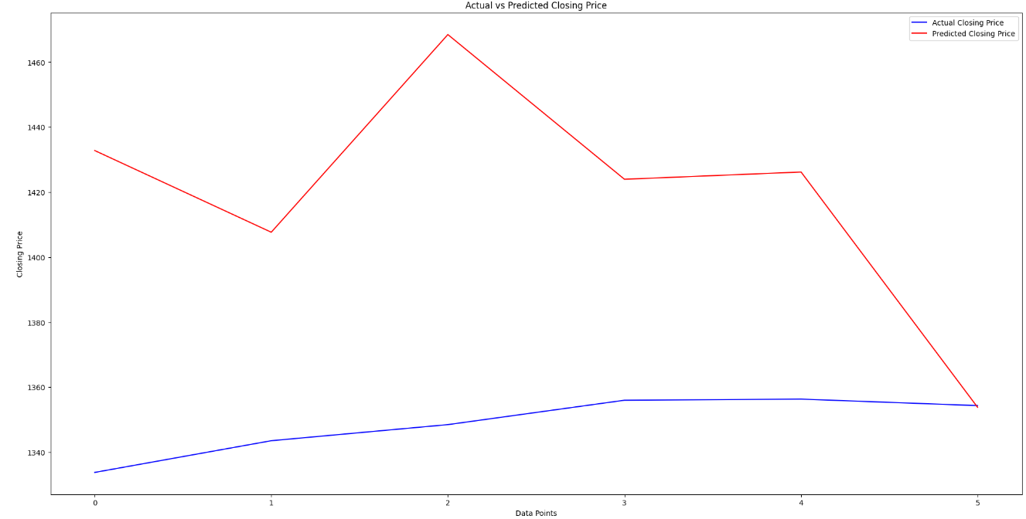
TensorFlow
TensorFlow:
TensorFlow is an open-source machine learning framework developed by the Google Brain team. It is designed to facilitate the development and training of deep learning models. TensorFlow provides a comprehensive set of tools, libraries, and community resources for building and deploying machine learning applications.
RMSE – 79.37

Slide 21
Accuracy comparison
Modelling Technique | Model Evaluation Score (RMSE)
ARIMA | 81.16
SARIMAX | 33.26
RandomForestRegressor | 3.15
RF + gridSearchCV | 3.91
RF + RandomizedSearchCV | 3.79
Linear Regression | 1.66
XGBRegressor | 1.39
TensorFlow | 79.37

Slide 22
Conclusion
Linear Regression and XGBoost models emerged as clear winner here. Hence we will conclude the project with these two models. Hence, we prepared our recommendation and conclusion based on that.
While at one side, we have given a recommendation to trader to buy, sell or hold a share, on another side we gave them a regression value so that trader has pre-assumption on what he/she will get on financial terms.

Slide 23
Thank You

